Slide 1
Computer Network
Carrier Sense Multiple Access with Collision Detection(CSMA/CD).
Binary Back Off Algorithm .

Slide 2
CSMA/CD
Concept:-
When the medium is not busy ,the node send its data.
If it sense that the medium is busy then it will back off and wait for random period of time and try again.
Access method of Ethernet :- CSMA/CD
Step 1: Sense the carrier .
Step 2: If carrier is Idle ,then transmit data .
Step 3: Else if carrier is busy, then
Step 4: (a) Wait for random period of time
(b) Go to step1.

Slide 3
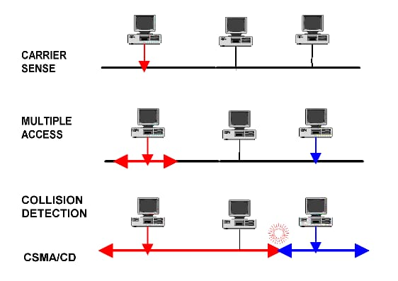

Slide 4
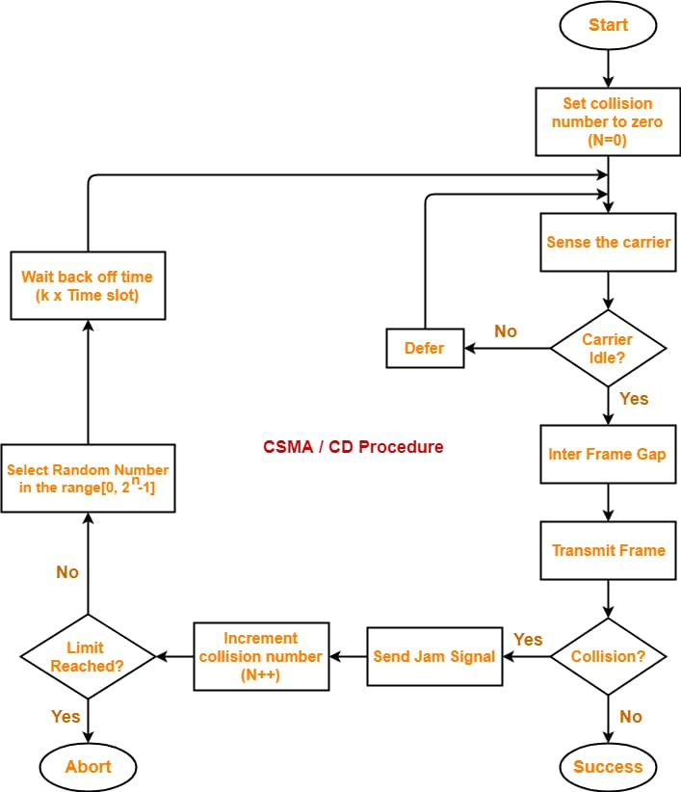

Slide 5
Binary Back Off Algorithm
When two nodes transmit there data at the same time then at a point their data collide with each other, this point is called point of collision .
After collision ,jamming signal is announced to each node then they detect that their data are collide.
So binary back off algorithm is used to schedule retransmission of data in Ethernet .
It is a collision resolution mechanism. It tells us about the probability of collision in the backbone cable and also the waiting time of each nodes.

Slide 6
A
B
Some factor used in algorithm :-
n = number of collision
contention window = range of number (0 to 2 -1)
waiting time = random number choose from contention window x T slot
n
1
2
3
A
B
1
2
3
Transmission of packet 1 at node A:-
n = 1
CW={o,1}
Transmission of packet 1 at node B:-
n=1
CW={0,1}

Slide 7
Combination:-
A | B | Result
0 | 0 | Collision
0 | 1 | A (transmit data)
1 | 0 | B (transmit data)
1 | 1 | collision
Probability of node A = 1/4
Probability of node B = 1/4
Probability of collision = 1/2

Slide 8
A
B
2
3
1
2
3
Transmission of packet 2 at node A :-
n = 1
CW = {0,1}
Transmission of packet 1 at node B :-
n = 2 ( 1 packet under collision)
CW = {0,1,2,3}

Slide 9
Combination :-
A | B | Result
0 | 0 | Collision
0 | 1 | A (transmit)
0 | 2 | A (transmit)
0 | 3 | A (transmit)
1 | 0 | B (transmit)
1 | 1 | Collision
1 | 2 | A (transmit)
1 | 3 | A (transmit)
Probability of node A = 5/8
Probability of node B = 1/8
Probability of collision = 1/4

Slide 10
A
B
3
1
2
3
Transmission of packet 3 at node A :-
n = 1
CW = {0,1}
Transmission of packet 1 at node B :-
n = 3 ( 2 packet under collision)
CW = {0,1,2,3,4,5,6,7}

Slide 11
A | B | Result
0 | 0 | Collision
0 | 1 | A (transmit)
0 | 2 | A (transmit)
0 | 3 | A (transmit)
0 | 4 | A (transmit)
0 | 5 | A (transmit)
0 | 6 | A (transmit)
0 | 7 | A (transmit)
1 | 0 | B (transmit)
1 | 1 | Collision
1 | 2 | A (transmit)
1 | 3 | A (transmit)
1 | 4 | A (transmit)
1 | 5 | A (transmit)
1 | 6 | A (transmit)
1 | 7 | A (transmit)
Combination :-

Slide 12
Probability of node A = 13/16
Probability of node B = 1/16
Probability of collision = 1/8
NOTES:-
Probability of collision is exponentially decreases.
If a station win collision one time then its probability of winning successive collision is going to increase exponentially.
This is capture effect.
So above is exponential binary back off algorithm to get number of collision in Ethernet and CSMA/CD.
Name :- Saloni Sinha
Roll :- 54
Session :- 2020-2023
That’s all
Thank you

